Slide 1

Exploratory Data Analysis of Large-Scale Retail Transaction Data
By Manasmita Mohakud
Exploratory Data Analysis of Large-Scale Retail Transaction Data
NextHikes IT Solutions
NextHikes IT Solutions
By Manasmita Mohakud

Slide 2

Introduction to Exploratory Data Analysis
What is EDA?
A crucial statistical approach used to summarize, visualize, and understand datasets before applying predictive models.
Project Scope: Detailed EDA on a large retail transaction dataset containing 100,000 records and 18 variables.
Core Focus: Statistical distribution analysis, uncovering relationships between variables, and identifying unusual patterns.

Slide 3
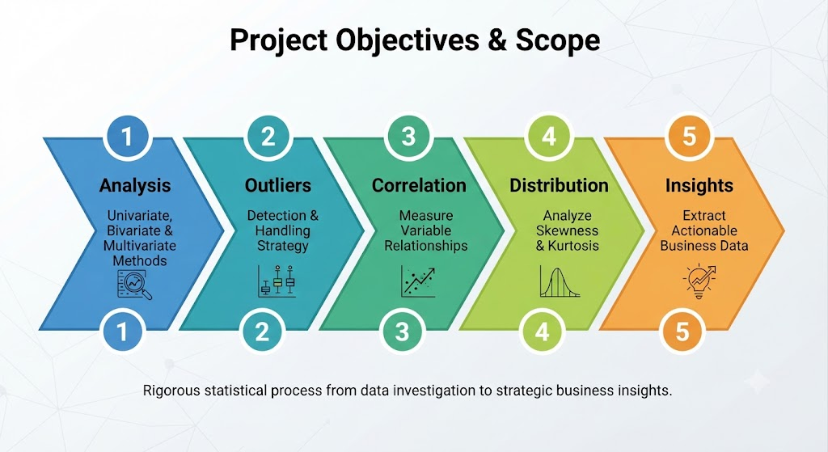
Situation Overview & Objectives
Project Objectives & Scope:
* Perform rigorous univariate, bivariate, and multivariate analyses.
* Detect and interpret data outliers accurately.
* Measure correlation between multiple numerical variables.
* Analyze data distribution features such as skewness and kurtosis.
* Extract statistically meaningful and actionable business insights.

Slide 4
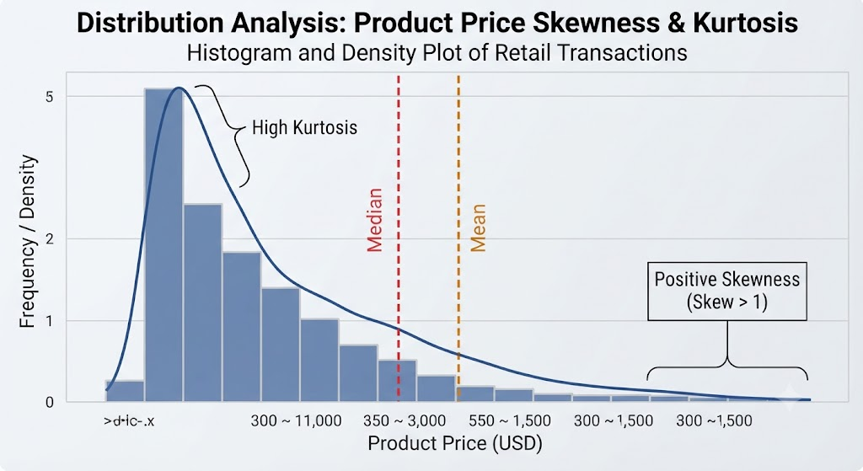
Univariate Analysis – Numerical Variables
Univariate Analysis: Numerical Variables
Computed Metrics: Mean, Median, Standard Deviation, Min/Max, Skewness, and Kurtosis.
‘product_price’ showed positive skewness (more lower-priced products than expensive ones).
‘final_price’ exhibited high kurtosis, indicating extreme values from bulk purchases.
‘discount_percentage’ was uniformly distributed between 0–30%.

Slide 5
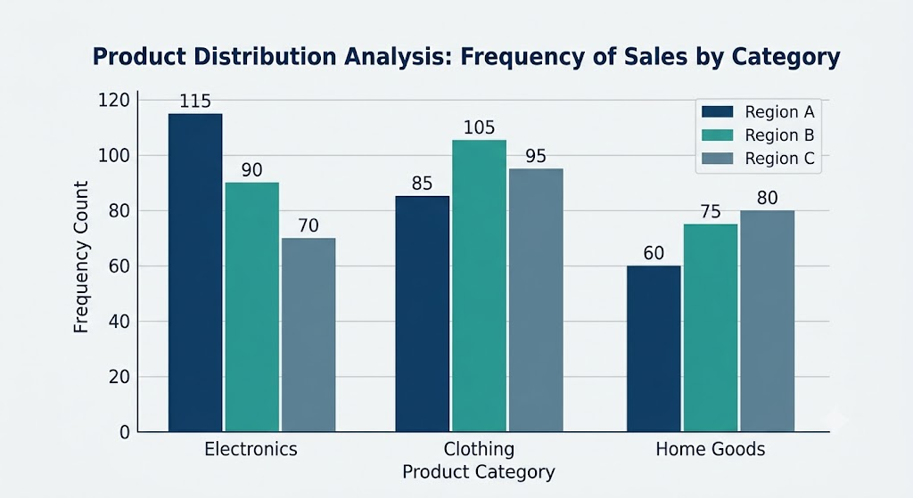
Univariate Analysis – Categorical Variables
Univariate Analysis: Categorical Variables
Analyzed categories: ‘product_category’, ‘customer_segment’, ‘payment_method’, and ‘return_status’.
Majority of customers belonged to the "Regular" segment.
The “Electronics” category recorded the highest transaction count.
Baseline return rate hovered around “15%”

Slide 6
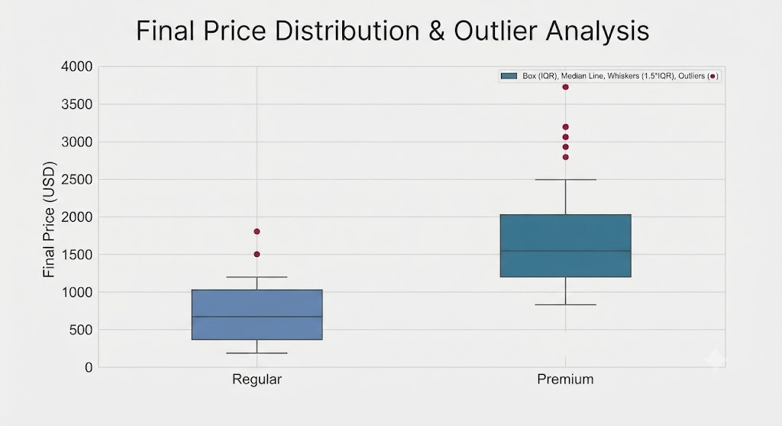
Outlier Detection & Interpretation
Outlier Detection & Handling
Detection Methods:
Boxplots, Interquartile Range (IQR) method, and Z-score method.
Extreme values were prominently observed in ‘product_price’.
High outliers in ‘final_price’ mapped directly to high-quantity purchases and premium tiers.
Handling Strategy: Outliers were retained as they represent genuine high-value business transactions.

Slide 7
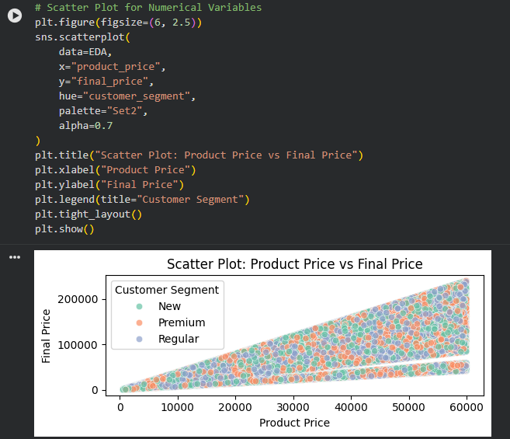
Bivariate Analysis – Numerical vs Numerical
Bivariate Analysis: Numerical vs. Numerical
Methodology: Pearson correlation analysis.
Strong positive correlation- between `product_price` and `final_price`.
Strong positive correlation - between quantity purchased and ‘final_price’.
Weak correlation - between customer age and total spending.
Slight positive correlation - between delivery days and return status.

Slide 8
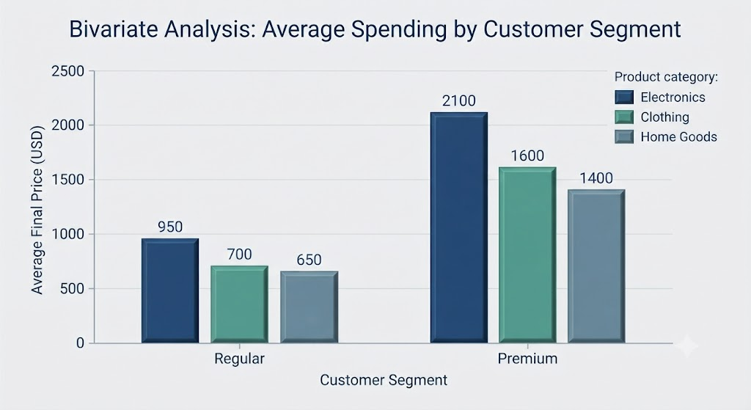
Bivariate Analysis – Numerical vs Categorical
Bivariate Analysis: Numerical & Categorical
Customer Segment vs. Average Final Price:
Premium customers consistently exhibited higher average spending levels.
Product Category vs. Return Rate: Electronics displayed slightly elevated return rates.
Shipping Type vs. Delivery Days:
Express shipping significantly reduced delivery turnaround times.

Slide 9
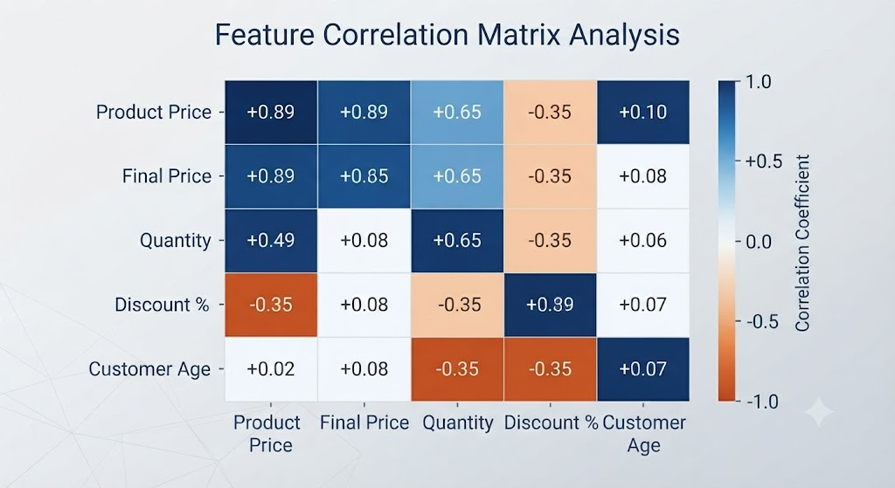
Correlation Matrix & Heatmap Analysis
Correlation Matrix & Heatmap Analysis:
Mapped linear associations across all numerical variables.
‘final_price’ correlates strongly with ‘product_price’ and quantity, and negatively with ‘discount_percentage’.
Delivery days display minimal correlation with customer spending.
No severe multicollinearity issues were detected among independent features.

Slide 10
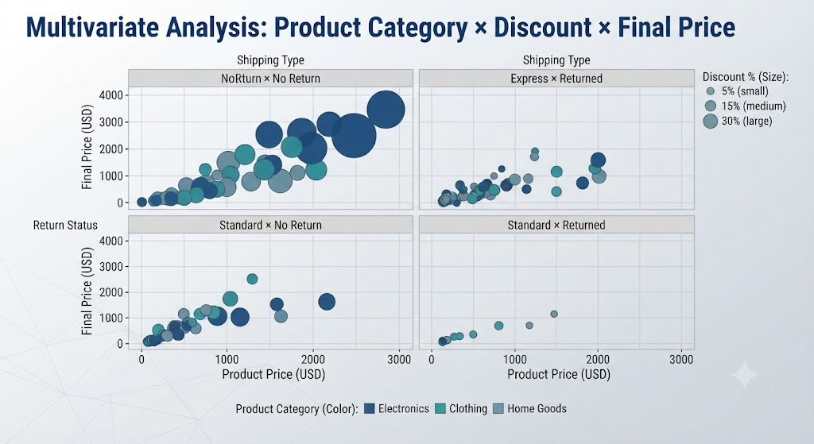
Multivariate Analysis – Complex Interactions
Multivariate Analysis: Multi-Variable Insights:
Product Category × Discount × Final Price:
Electronics items paired with moderate discounts generated the highest overall revenue.
Customer Segment × Age × Spending:
Premium customers in the 30–45 age bracket recorded maximum spending volume.
Delivery Days × Shipping Type × Return Status:
Standard shipping combined with longer delivery durations notably increased return probabilities.

Slide 11
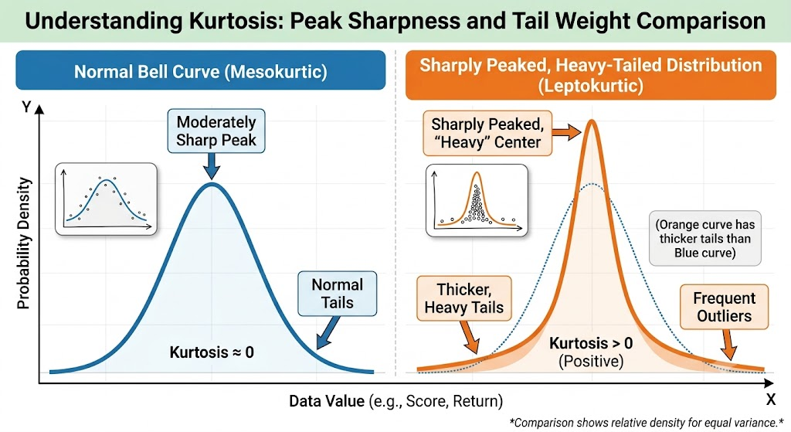
Skewness & Kurtosis Interpretation
Distribution Analysis: Skewness & Kurtosis:
Positive Skewness (‘product_price’, ‘final_price’): Majority of transactions are small-to-medium sized, interspersed with a select few large transactions.
High Kurtosis (‘final_price’): Signifies heavy tails and extreme purchase behaviors.
Business Utility:Successfully pinpoints distribution asymmetry and potential financial risk zones.

Slide 12
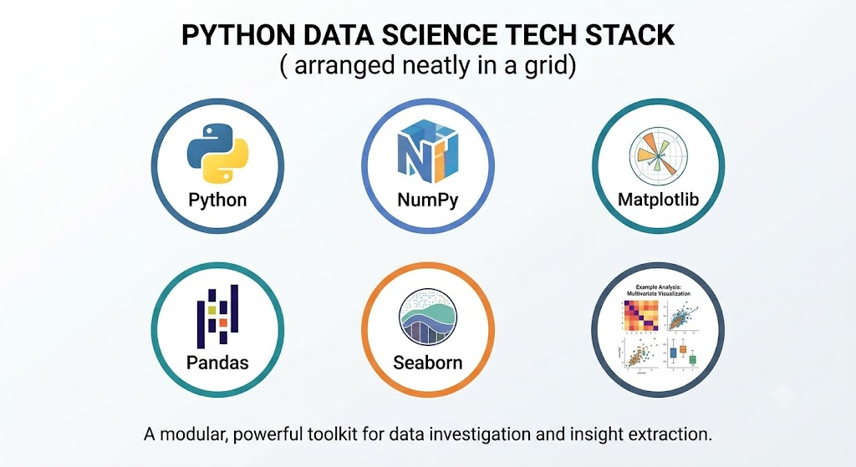
Core Technical Libraries Used
Core Technical Stack & Libraries:
NumPy:Multidimensional array objects and mathematical operations.
Pandas: Data manipulation, cleaning, and structural analysis.
Matplotlib: Core visualization library for 2D charts and plots.
Seaborn: Advanced statistical graphics built on top of Matplotlib.

Slide 13
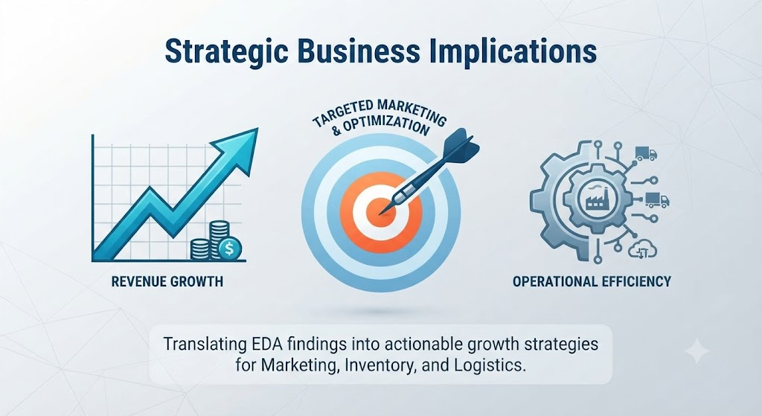
Strategic Business Implications
Strategic Business Implications:
Targeted Marketing:
Focus campaigns on the high-spending 30–45 age demographic within premium customer segments.
Inventory Management:
Prioritize high-demand categories like Electronics while closely monitoring return trends.
Logistics Optimization:
Expand express shipping offerings to curb return rates linked to extended delivery times.

Slide 14
Conclusion & Future Scope
Successfully executed univariate distributions, bivariate relationships, multivariate interactions, correlation studies, and outlier detection.
Provides a rock-solid statistical foundation for deploying high-performing predictive machine learning models and driving data-backed retail decisions.

Slide 15


